Slide 1
Pay and Personnel Center Presentation 2021 CGNRC Annual Meeting Presented by: CAPT Derek Smith

Slide 2
Discussion
CRDP/AEW
Communications and Support from PPC

Slide 3
CRDP/AEW
Prior to March 2020 entirely manual process
March 2020 fully established new AEW section and new automated process
Reduced turnaround time to no longer than 120 days

Slide 4
CRDP/AEW continued
April 2020 PPC had a backlog of over 5800 AEWs.
January 2021 reduced case processing to under 1300.
Since January PPC has been able to process all AEW’s in under 120 days.
Current average is 75 days

Slide 5
Communications and Support from PPC
PPC was receiving feedback that calls coming into the Call Center were not properly tracked or followed up on.
Answered promptly but trouble with ticket follow through.
January 2021 re-established Call Center in RAS to focus on retirees and possibly work some issues on the phone.
Feedback that wait times were up to an hour to speak to a Call Center technician.

Slide 6
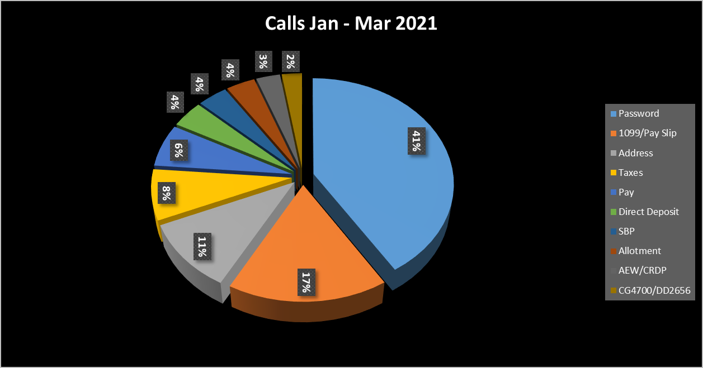
Data Analysis
73% of the call volume did not require specific RAS pay knowledge .
Password
1099/Pay Slip
Address
Direct Deposit

Slide 7
Solution
16 August a revised process was put into place.
All calls can be answered by Customer Care or RAS Call Center personnel.
The 73% of basic calls highlighted earlier will be handled on the spot by call technicians. No tickets will be created.
The 27% of calls that are retiree specific and require RAS intervention will be routed to RAS via a trackable ticket to a RAS call rep.
Tickets will be either completed within seven days or RAS personnel will reach out to the retiree for explanation and estimated completion times.

Slide 8
Results

Slide 9
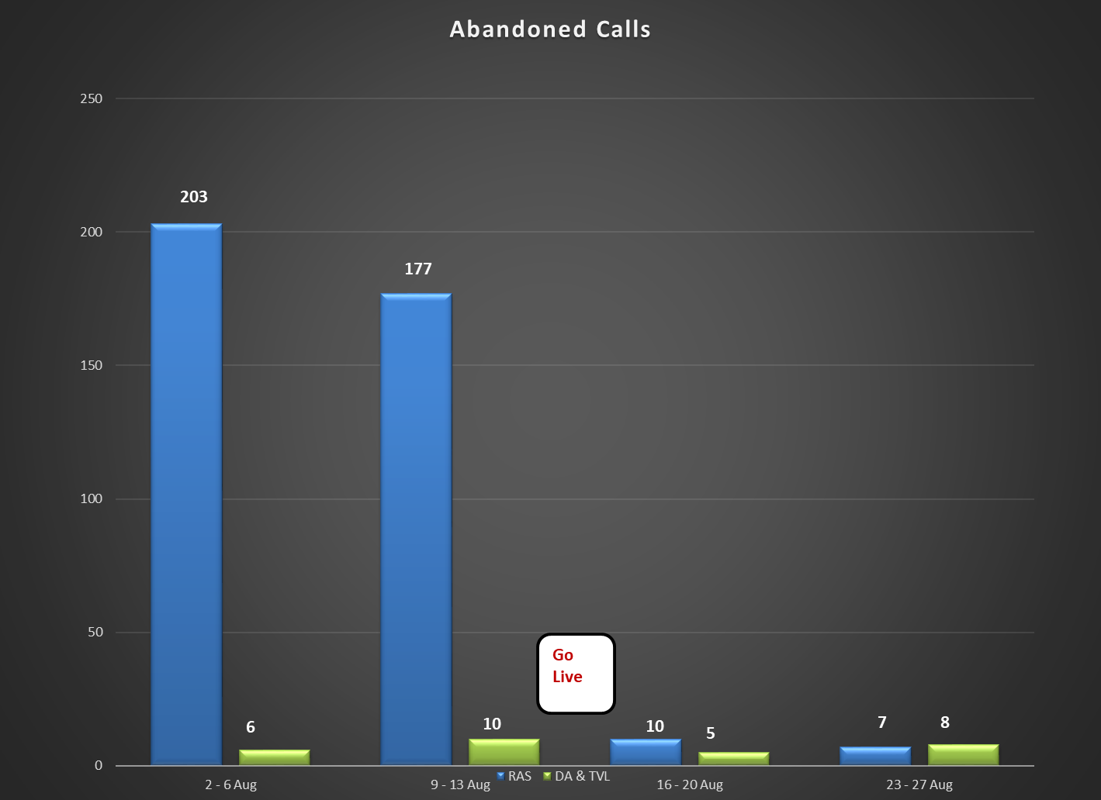
Results

Slide 10
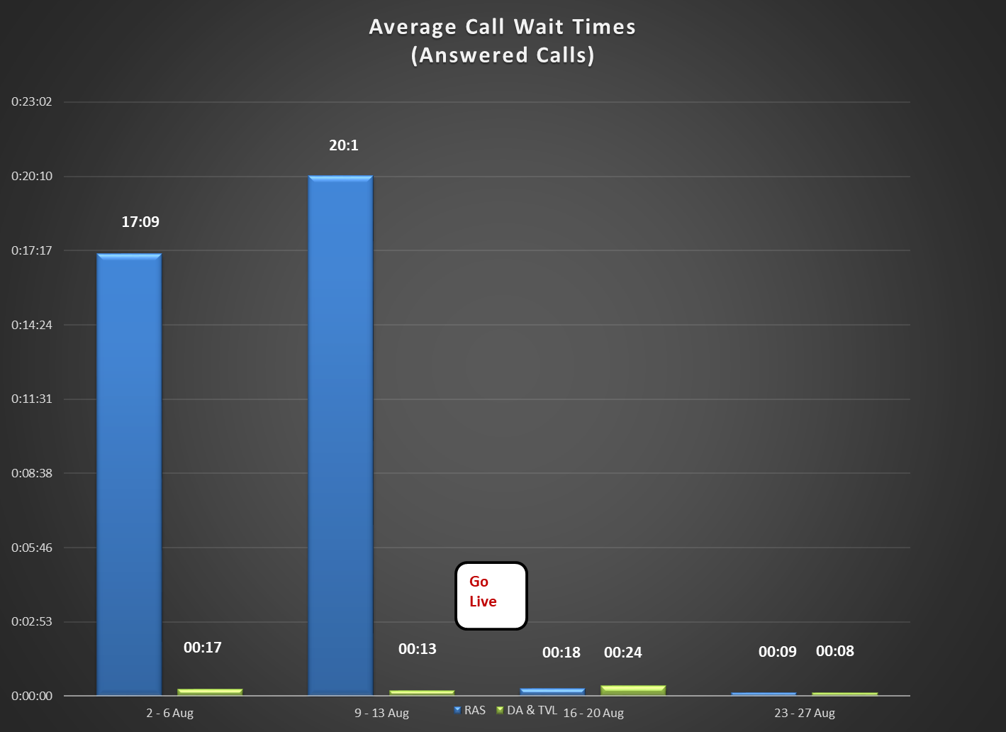
Results

Slide 11
Future Intentions
Create more transparency on tickets.
Use standardized response times.
Revise external facing website to make it more user friendly, thus encouraging great use of self service.
Create online templates for queries and actions
Allotment Starts
Taxes
Direct Deposit changes
Work with CGNRC to direct more retirees to self-help options within.

